Slide 1




Bank Loan Analysis
Domain – Finance
Project - Bank loan of customers
Project By - Group 3 ( P349 )
Mr. Ritesh Dnyaneshwar Gawas
Mr. Harshal Bajirao Shintre
Mr. Vedant Uttam Ghatage
Mr. Vishwadip Shivaji Shinde
Mr. Kalpesh Bhagwat Patil
Mr. Abhijit Nandkumar Jadhav
Miss. Sakshi Rajendra Zaware

Slide 2
Project Objective
Study and Clean Data -
Study the loan data provided, understand its structure and variables.
Clean the data by addressing missing values, unusual data points, and inconsistencies.
2. Data Model Preparation -
Create a structured data model to organize the loan data efficiently for analysis.
Define relationships between different tables/entities if applicable.
3. Analysis with Key Performance Indicators (KPIs) -
Use predefined Key Performance Indicators (KPIs) like Year wise loan amount, State wise loan status etc.,to evaluate loan performance.
4. Visual Reports Using Interactive Tools -
Utilize Excel, Power BI, Tableau, and MySQL for creating interactive visual reports.
Design visually appealing dashboards and reports to present the analyzed data effectively.
5. Insights & Suggestions -
Provide insights derived from the analysis, such as trends, patterns, and correlations in the loan data.
Offer suggestions for improving loan performance , risks, or optimizing lending strategies based on the analytical outcomes.

Slide 3




Tools Used
We've utilized four different tools to create interactive dashboards and gain insights from our dataset :
Excel, Power BI, MySQL, and Tableau. Each of these tools has been used to design a dashboard that presents the data in an interactive and visually appealing manner. This approach allows us to explore the dataset effectively and extract meaningful insights to inform decision-making.

Slide 4

Key Performance Indicators (KPI’s) -
In addition to the datasets, we've been given 5 Key Performance Indicators (KPIs) to help analyze the data. To enhance clarity and provide a more comprehensive view, we've also included additional KPIs such as total customers, average interest rate, and total loan amount. These additions help in presenting the data more clearly and enable better understanding of the overall picture.
Year Wise Loan Amount
Grade-Subgrade wise revolving balance
Total Payment For Verified Status Vs Non Verified Status
State Wise Last credit pull date Wise Loan Status
Home Ownership Vs Last Payment Date Stats
1
2
3
4
5

Slide 5
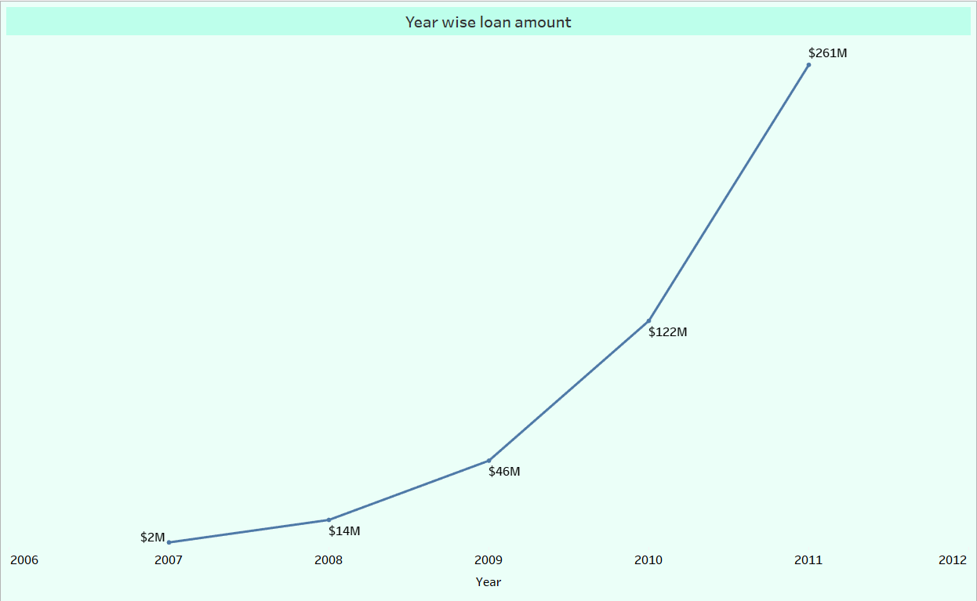
KPI 1 – Year Wise Loan Amount
Insights Or Suggestions –
In this chart, as we can observe, the loan amounts are presented year by year. It is shown that the bank issued loans starting from the year 2007, with an initial amount of 2 million, and this amount increased annually. In the year 2011, it reached its peak at 261 million.
The significant growth in loan amounts from 2009 to 2011 can be attributed to several factors, such as increased demand for larger loans, changes in lending policies of companies, or a rise in the number of customers seeking loans.
If we monitor the trend in loan amounts, we can ensure that it aligns with the company's risk tolerance and does not adversely affect its financial stability.

Slide 6
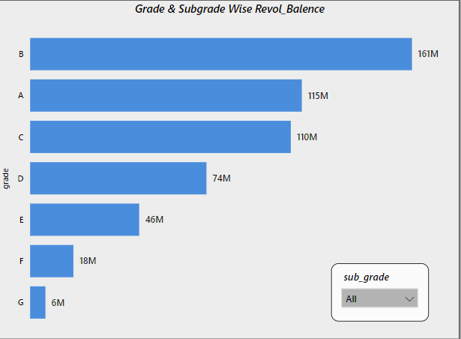
KPI 2 – Grade and Sub-grade wise Revolving Balance
To understand the data more deeply, we’ve added a slicer for sub-grades. This allows us to break down the information within each grade and see how different sub-grades within the same grade might perform.
Insights Or Suggestions –
In this chart, we can see the revolving balance for each grade. Grade B has the highest revolving balance at 161 million, followed by Grade A at 115 million, and Grade C at 110 million. Grades F and G have low revolving balances, with Grade G having the lowest balance at 6 million.
Grades B and C have the highest average revolving balances, indicating a significant amount of unpaid loan balances. Adjusting lending criteria for these grades might be necessary to reduce the accumulation of unpaid balances. Offering better terms could encourage timely repayment.
Grades F and G have low revolving balances. To improve performance in these grades, consider offering special incentives or terms for loans in Grade G.

Slide 7
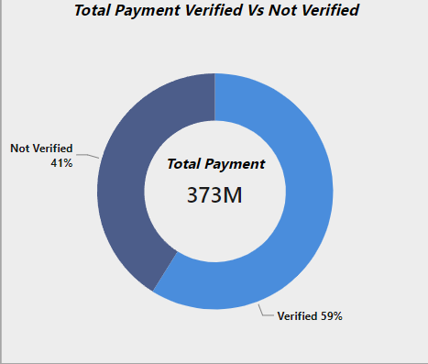
KPI 3 – Total payment verified Vs Total Payment Non-verified Status
Insights Or Suggestions –
The majority of total payments, specifically 59%, are verified, indicating a high level of reliability and trustworthiness. This percentage suggests that verified transactions are indeed more secure, which is a positive indicator for payment security.
The remaining 41% of payments are not verified, indicating that the verification process either hasn't been completed or hasn't provided confirmation. This presents an opportunity for improvement in the verification process for these transactions.
By enhancing the verification steps or addressing any underlying issues, we can increase the reliability and trustworthiness of these payments, thus further strengthening payment security.

Slide 8
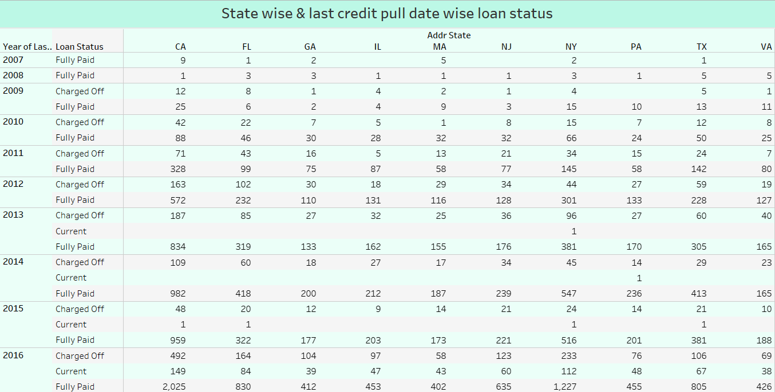


KPI 4 – State wise and last_credit_pull_date wise loan status
Here, we have added two filters to this chart: "States" and "Address States", allowing us to explore the data more thoroughly. The "State" filter will display the top-ranked states, while the "Address States" filter provides access to the data for each state individually.
Insights Or Suggestions –
The number of "Fully Paid" loans has been increasing steadily over time, while the number of "Charged Off" loans has fluctuated. This suggests that there is an overall growth in the loan market, with some ups and downs in defaults.
The number of "Fully Paid" loans is consistently much higher than the number of "Charged Off" loans, indicating that a majority of borrowers are able to repay their loans .
California (CA) has the highest number of both "Fully Paid" and "Charged Off" loans, followed by New York (NY). This suggests that these states have a larger and more active loan market.
The years 2016, 2015, and 2014 witness the highest number of "Fully Paid" loans, coinciding with the peak years for "Charged Off" loans. This suggests a significant increase in loan activity during these years.

Slide 9
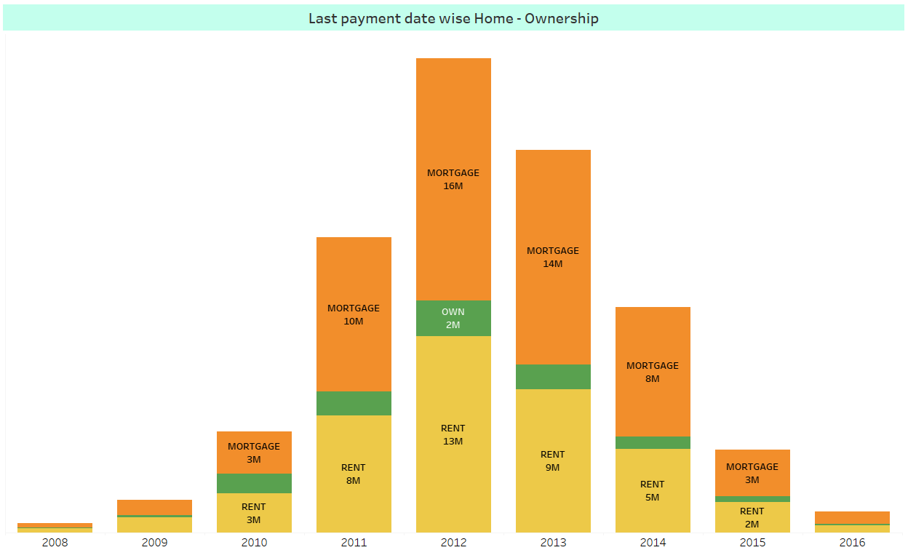

KPI 5 – Home ownership Vs last payment date stats
Here, we have added a home ownership filter to allow for a more in-depth analysis of the data, enabling us to examine the statistics for each type of home ownership individually.
Insights Or Suggestions –
In the bar plot representation, home ownership is categorized into three types: mortgage, own, and rent, indicated by different colors: orange, green, and yellow, respectively.
The amount of home ownership varies from 2008 to 2016, with the maximum amount reached in the year 2012, at around 31 million. The minimum amount is observed in 2008.
Mortgage ownership fluctuated over the years, with peaks in 2011 and 2013. Meanwhile, fully owned homes reached their highest point in 2011, gradually decreasing afterward. Regarding rental homes, there was steady growth until 2012, followed by a significant drop by 2016. Initially, more people chose to rent, but later shifted to other forms of ownership.

Slide 10
TOP KPI - "Here we also find key metrics, helping to highlight important information at a glance."
Total Customers ( 39 ,717) - This metric provides insight into the size of the bank's customer base, reflecting the number of individuals who have accounts or are otherwise engaged with the bank's services.
Total Loan Amount ( 446M ) – Total Loan Amount metric represents the sum total of all loans disbursed by our organization, encompassing various types of loans such as mortgages, personal loans, business loans, etc.
Average Interest Rate ( 12.02 % ) – The average interest rate, represented as 12.02%, is a key metric indicating the average rate at which interest is accrued or paid over a given period. This figure serves as a crucial indicator of the cost of borrowing or the return on investment for financial activities

Slide 11
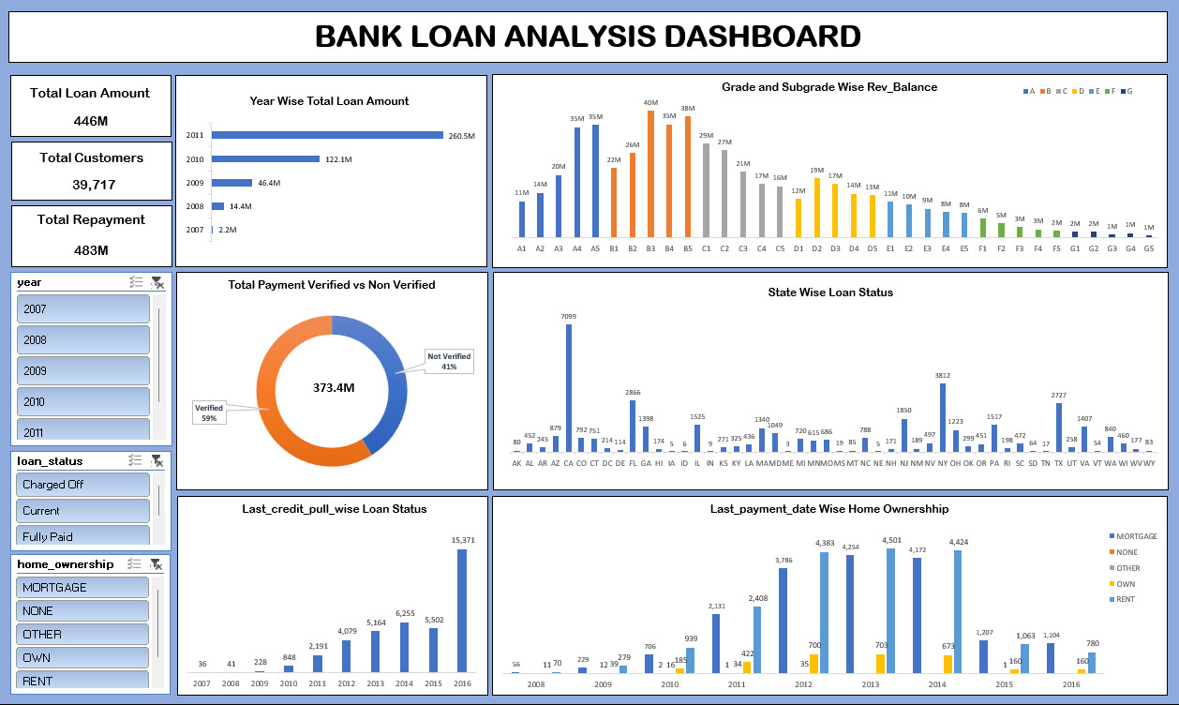
Excel Dashboard

Slide 12
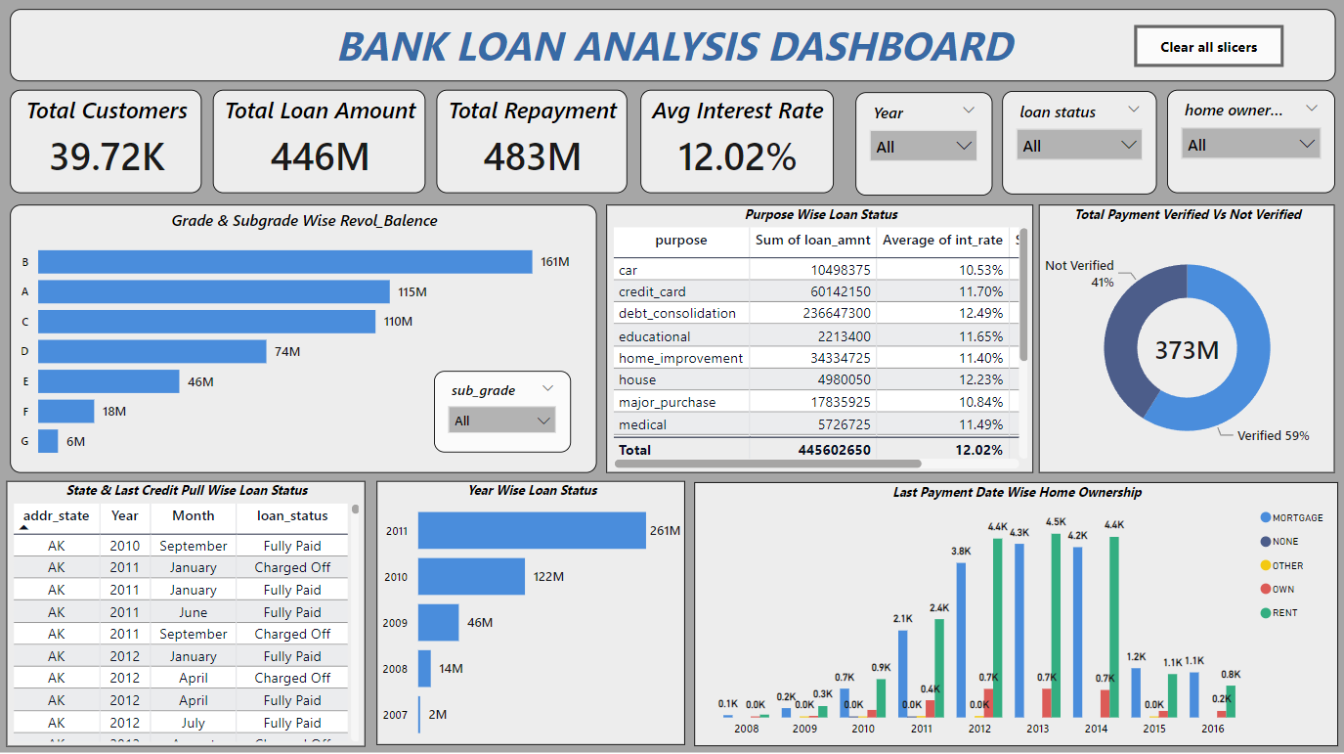
Power BI Dashboard

Slide 13
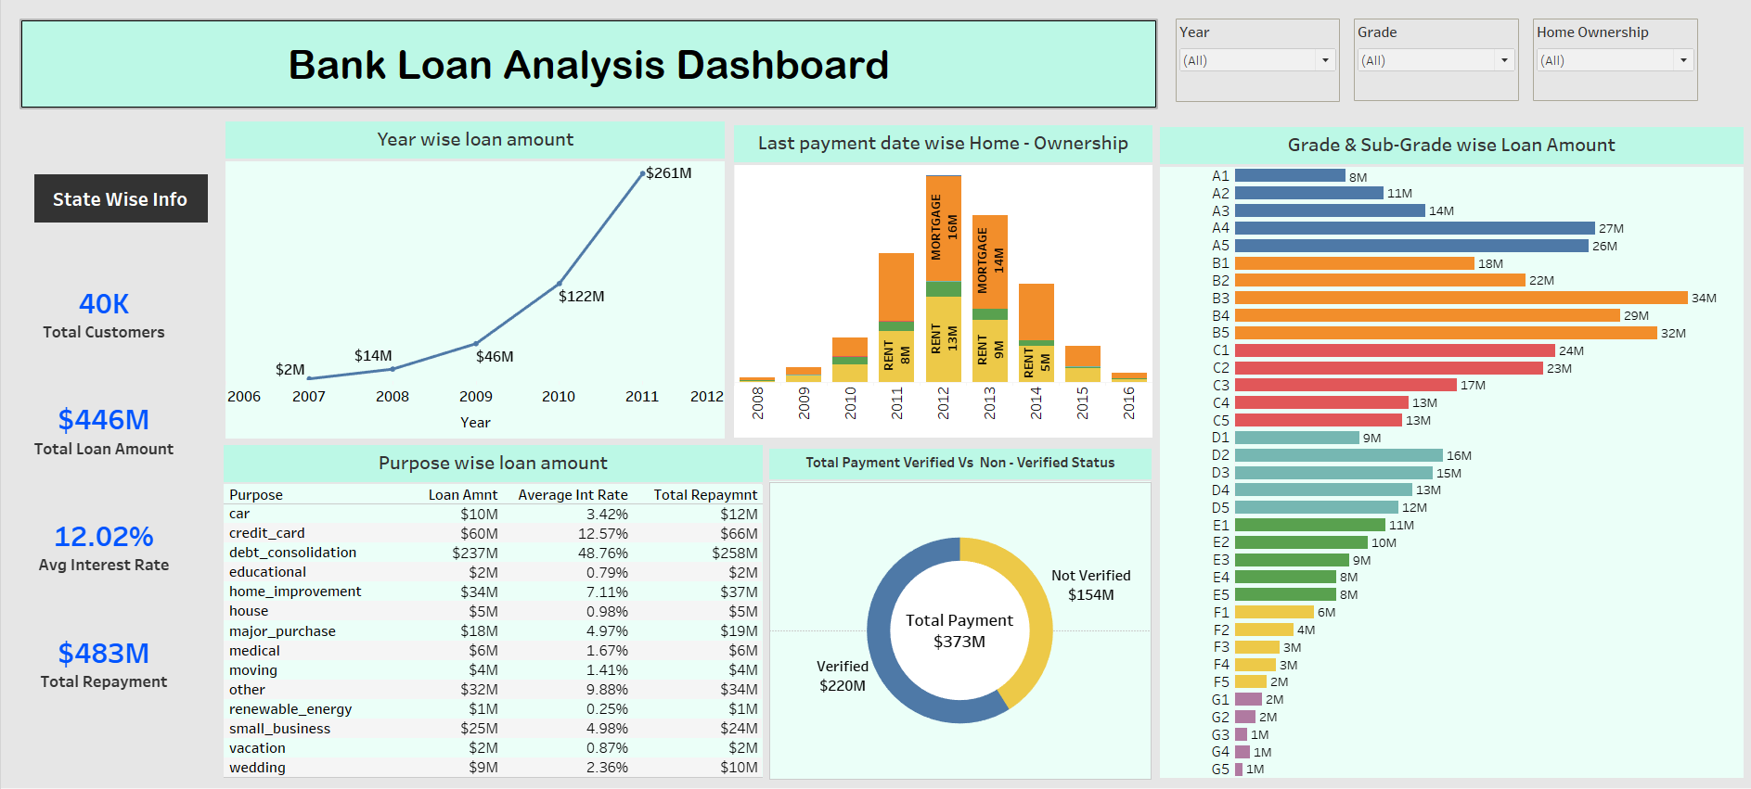
Tableau Dashboard

Slide 14
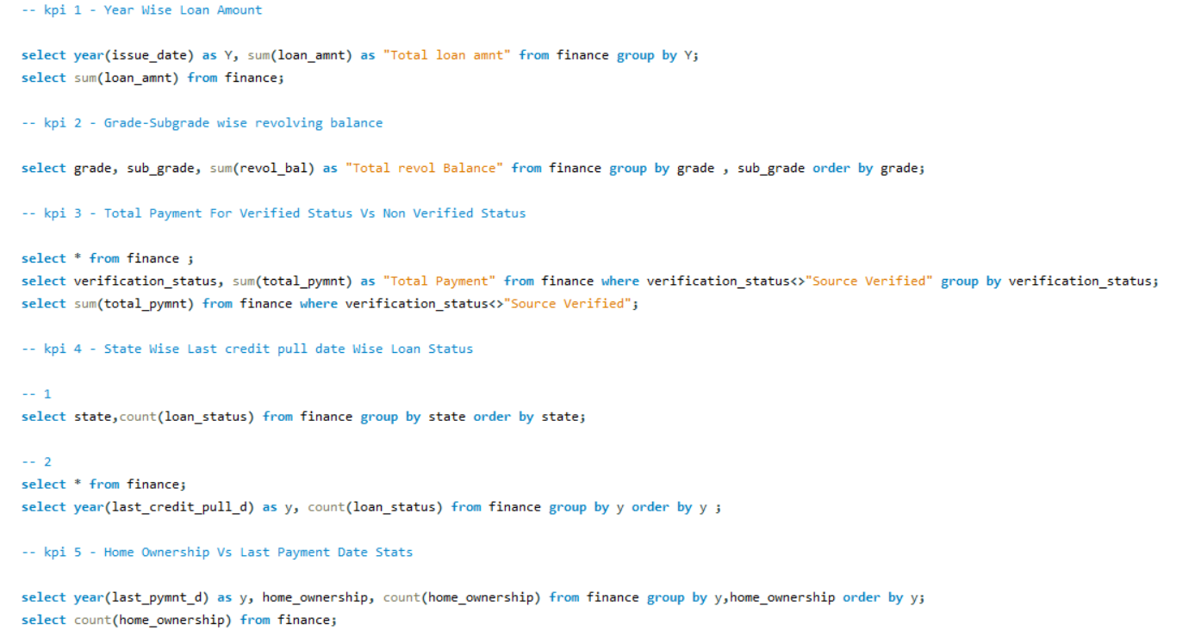
MySQL Script

Slide 15
Overall Suggestion / Conclusion
1. Consistent Monitoring and Analysis -
- Regularly check and analyze KPIs to find trends and detect unusual patterns.
- From the analysis of above dashboards and reports, we can find hidden insights.
2. Data-Informed Decision Making -
- Use insights derived from data to guide lending decisions and improve lending policies as necessary.
- With the use of gained insights from the given KPIs of the finance dataset, accurate business decisions are made and can track the business state.
3. Ongoing Evaluation and Improvement -
- Continuously review and strengthen verification and credit checking processes to lessen risks associated with lending.
4. Adaptation to Changing Conditions -
- Stay aware of shifts in borrower characteristics and market conditions, and adjust lending strategies accordingly.

Slide 16
Thank You !!

